Slide 1
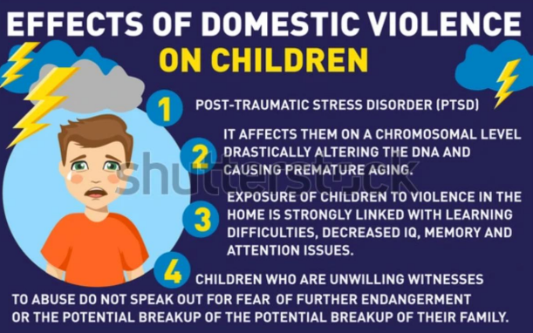
11th
Domestic Abuse
Anyone can be a victim of domestic abuse regardless of gender, age, ethnicity, socio-economic status, sexuality or background.
What is domestic abuse?
Domestic abuse is any type of controlling, bullying, threatening or violent behaviour between people in a relationship. It can seriously harm children and young people and witnessing domestic abuse is child abuse.
Domestic abuse can be emotional, physical, sexual, financial or psychological, such as :
• kicking, hitting, punching or cutting
• Controlling someone's finances by withholding money or stopping someone earning
• Controlling behaviour, like telling someone where they can go and what they can wear
• Not letting someone leave the house
• Reading emails, text messages or letters
• Threatening to kill someone or harm them
• Threatening to another family member or pet.
It's important to remember domestic abuse:
• Can happen over the phone, on the internet and on social networking sites
• Can happen in any relationship and can continue even after the relationship has ended both men and women can be abused or abusers.
What's important is to make sure the abuse stops and that children have a safe and stable environment to grow up in.

Slide 2
Since the Domestic Abuse Act 2021, children that have been exposed to domestic abuse are now recognised as victims of domestic abuse in their own right, rather than just witnesses.
Living in a home where domestic abuse happens can have a serious impact on a child’s mental and physical wellbeing, as well as their behaviour. This can last into adulthood.
Where to get support:
Safe Spaces
Safe Spaces are also available in Boots, Morrisons, Superdrug and Well pharmacies, TSB banks and independent pharmacies across the UK. Once you are inside, specialist domestic abuse support information will be available for you to access. Many Safe Spaces are also prepared to respond to the ‘Ask for ANI’ codeword, to provide victims with a discreet way to access help calling the police on 999 or specialist support services. Find your nearest Safe Space. https://uksaysnomore.org/safespaces/
The Men’s Advice Line https://mensadviceline.org.uk/ run by Respect is a confidential helpline specifically for male victims. 0808 801 0327 info@mensadviceline.org.uk
Victim Support
Victim Support run these services for victims and survivors of any abuse or crime, regardless of when it occurred or if the crime was reported to the police: free, independent and confidential 24/7 Supportline 08 08 16 89 111 https://www.victimsupport.or g.uk/help-and-support/gethelp/support-near-you/livechat/
Womens Aid
If you are experiencing domestic abuse or are worried about friends or family, you can access the Women’s Aid live chat service 7 days a week, 10am to 6pm. https://chat.womensai d.org.uk

