Slide 1
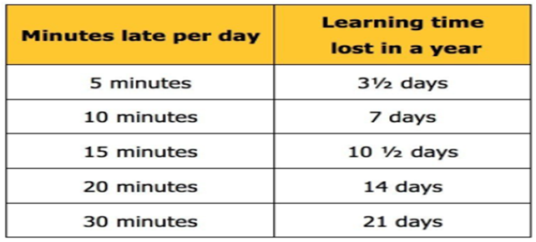
3rd
2025
Attendance
HOLIDAYS
Holidays in term time will have a detrimental effect on your child’s progress, as they miss chunks of their learning. In line with Sir Edmund Hillary’s policy, we will not authorise any holidays in term time.
Unauthorised holidays during term time will be referred to the Education Welfare Service for legal action to be considered.
Newsletter
Dear Parent/Carer,
Welcome to our July newsletter. The academic year will soon be coming to an end which means in the children’s end of year attendance letters will be sent out. Please take time to review your child’s attendance percentage and the category they have been placed into.
Research shows that regular attendance and good punctuality are crucial for children to achieve their full potential at school.
We aim for all children to have 100% attendance in order to make the most of the teaching and learning that is offered at Sir Edmund Hillary L.E.A.D. Academy.
We expect all children to finish the academic year above 96%. If this is not the case for your child this academic year please work with us to ensure they meet their individual target next year.
Did you know late marks affect your child’s attendance percentage? Pupils miss key information by arriving late which can cause your child to feel unsettled potentially affecting their learning and result in a referral to the Education Welfare Service.
Why not come to our breakfast club which opens at 7.30am everyday. The cost is £3 children have breakfast, play & have fun. What a fantastic start to their morning! Please book 24 hours prior via school comms.

Slide 2
We understand that appointments are sometimes necessary during the school day. Permission for your child to attend an appointment will be granted upon receipt of an official appointment confirmation. Ideally, this brought into school at least 24 hours in advance. However, we do appreciate emergencies can occur.
A Reminder:
Friday Afternoons are dedicated to our Celebration Assemblies, where we recognise and celebrate the achievements of our wonderful children. We kindly ask that you avoid scheduling appointments during this time whenever possible.
Thank you for your understanding and support.
Whole school attendance
95.9%
Please continue to ensure your child is in school everyday and on time. By working together the children can have the very best start in life.
Thank you for your ongoing support.

