Slide 1
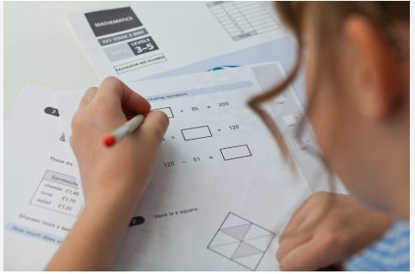
KS2 SATS 2026
Parents’ Meeting

Slide 2
When are SATs 2026?
Date | Paper/s
Monday 11th May 2026 | Spelling, Punctuation & Grammar – Paper 1 Spelling, Punctuation & Grammar – Paper 2
Tuesday 12th May 2026 | English Reading
Wednesday 13th May 2026 | Maths Paper 1 (Arithmetic) Maths Paper 2 (Reasoning)
Thursday 14th May 2026 | Maths Paper 3 (Reasoning)

Slide 3
Spelling, Punctuation and Grammar: Monday 11th May
Spelling, Punctuation and Grammar consists of two papers.
Paper 1 focuses on all three elements (spelling, punctuation and grammar). The paper lasts for 45 minutes.
Paper 2 consists of a spelling test only. It should take approximately
15 minutes, although this is not a set amount of time (pupils should be given as much time as they need to complete the test).

Slide 4
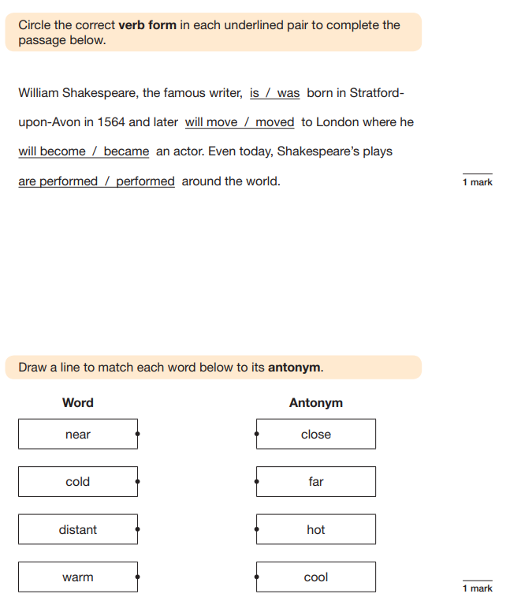
Grammar paper – what does it look like?
45 minutes
50 questions

Slide 5
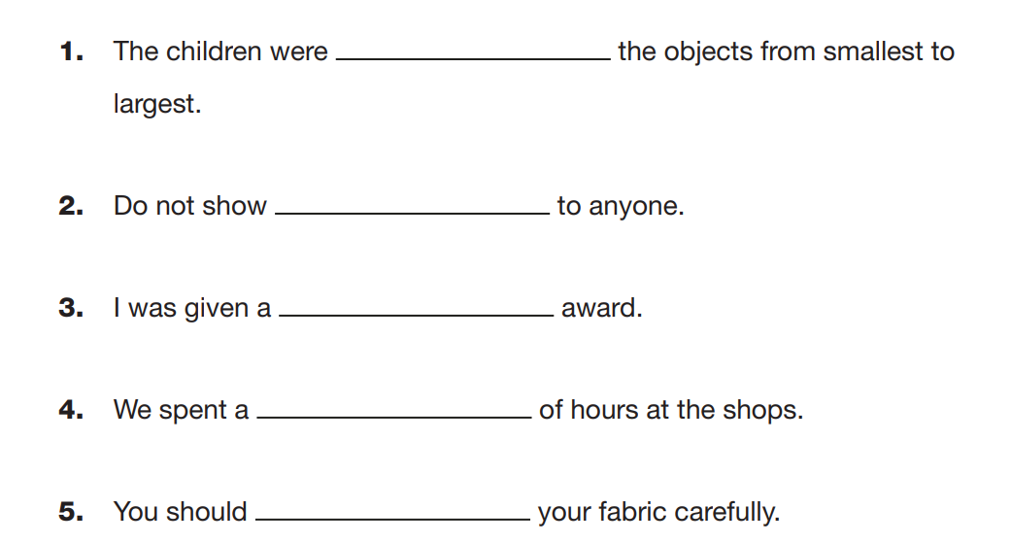
Spelling paper – what does it look like?
20 questions.
The teacher will read the whole sentence including the missing word.
The missing word is then read again.
The children insert the missing word.
The test is not timed but takes approximately 15 minutes.

Slide 6
Reading: Tuesday 12th May 2025
There is one reading test that lasts for 60 minutes.
The test is designed to measure if the children’s comprehension of age-appropriate reading material meets the national standard. There are three different set texts for children to read. These could be any combination of non-fiction, fiction and/ or poetry.

Slide 7
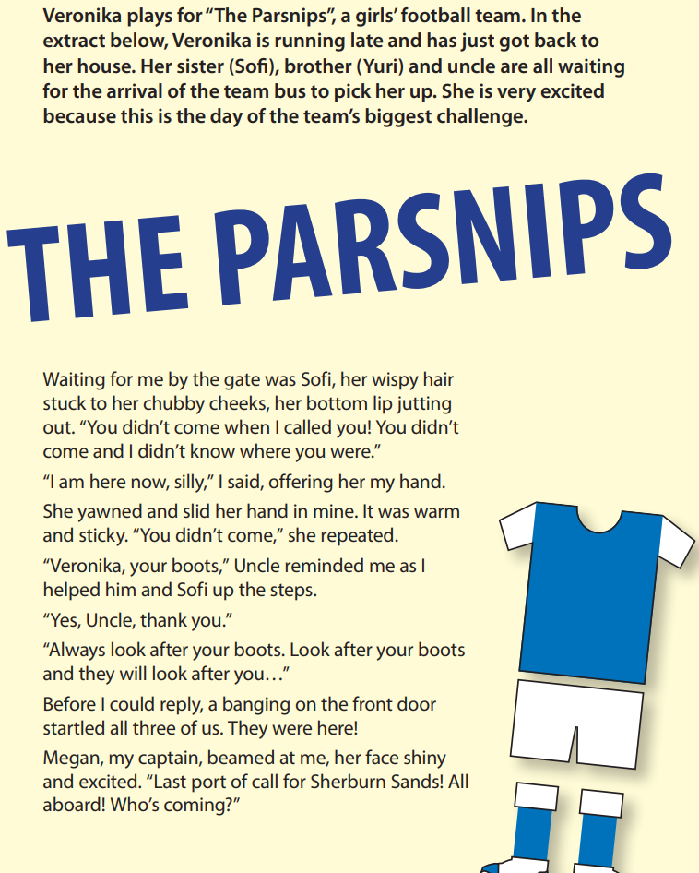
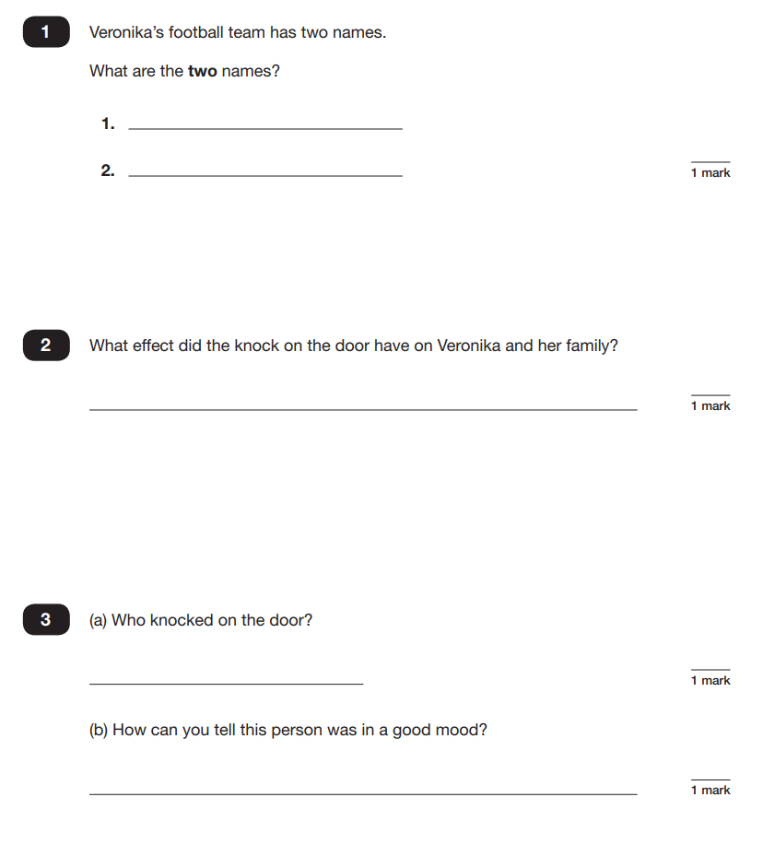
Reading paper – what does it look like?
The children will not have seen the texts before but will have studied the different text types in class.

Slide 8
Maths: Wednesday 13th May and Thursday 14th May
The maths assessments consist of three tests.
Paper 1: Arithmetic (30 minutes) – Wednesday 13th May
Paper 2: Reasoning (40 minutes) – Wednesday 13th May
Paper 3: Reasoning (40 minutes) – Thursday 14th May

Slide 9
Maths Paper 1 (Arithmetic)
The maths arithmetic paper has a total of 40 marks.
The test covers the four operations (addition, subtraction, multiplication, division, including order of operations requiring BODMAS), percentages of amounts and calculating with decimals and fractions.
Notes:
Identify that there are some questions that have 2 marks and some that have 1. If the answer to this question is wrong, children could still get a mark for a correct method containing an error.

Slide 10
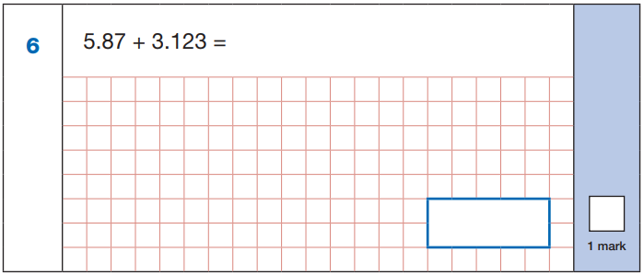
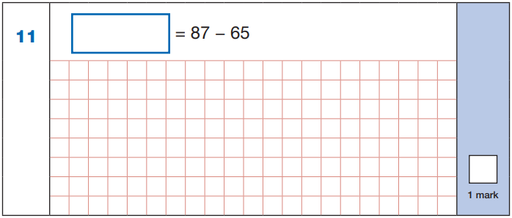

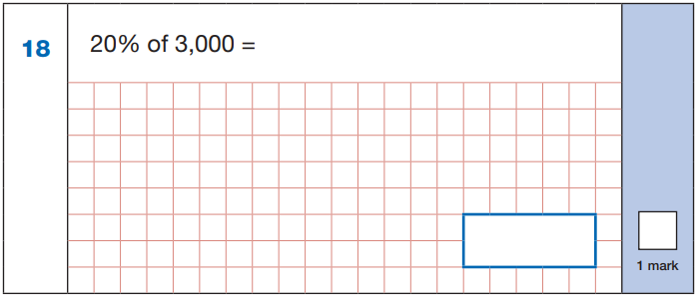
Maths Paper 1 (Arithmetic)
Here are some example questions. Again, children would be expected to complete roughly one question per minute.

Slide 11
Maths Paper 1 (Arithmetic)
Answers:
22
5.87
+ 3.123
8.993
87
- 65
22
8.993
60 ÷ (30 - 24)
60 ÷ 6 = 10
10% of 3,000 = 300
20% of 3,000 = 600
10
600
Notes:
These are examples of how children could solve the calculations. There are some that could/ should be solved mentally as it is far quicker that way (40 marks in 30 minutes does not allow for 1 minute + per mark).
Answers should always be given in their simplest form unless stated otherwise (e.g. for question 11, 20 + 2 would not be accepted as a correct answer).

Slide 12
Maths Papers 2 and 3 (Reasoning)
Paper 2 will take place on Wednesday 13th May and paper 3 will take place on Thursday 14th May. These tests have a total of 35 marks each.
These papers require children to demonstrate their mathematical knowledge and skills, as well as their ability to solve problems and their mathematical reasoning. They cover a wide range of mathematical topics from key stage 2 including,
Number and place value (including Roman numerals);
The four operations;
Geometry (properties of shape, position and direction);
Statistics;
Measurement (length, perimeter, mass, volume, time, money);
Algebra;
Ratio and proportion;
Fractions, decimals and percentages.
Notes:
In general, the questions get progressively harder throughout the paper. As this is the case, it is not unusual for children to be unable to complete the entire paper in the given time. Maths Paper 1 (Arithmetic)

Slide 13
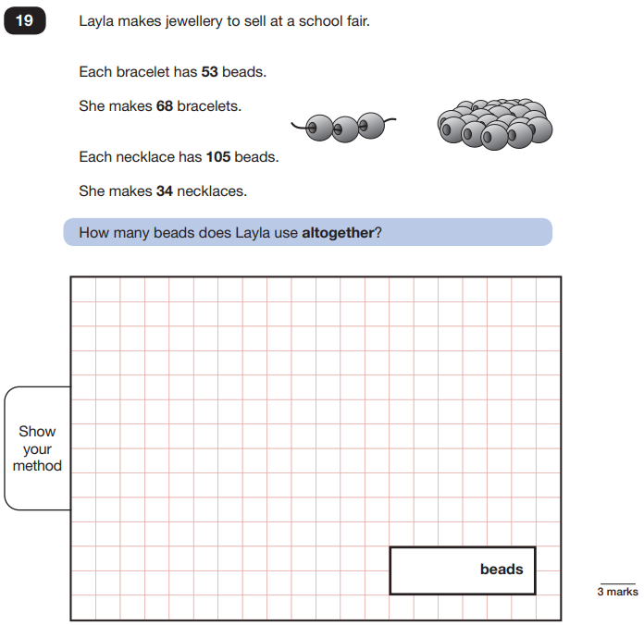
Maths Papers 3 (Reasoning)
Example question:
Notes:
Note that this is a three mark question.

Slide 14
Scaled Scores
In KS2, the papers are marked externally, with no teacher assessment involved.
Your child will receive a raw score which will be converted into a scaled score. The range of scaled scores available for each KS2 test ranges from 80 to 120.
A scaled score of 99 or less means that the child has not yet met the government expected standard.
A scaled score of 100 or more means that the child has met the expected standard.
A scaled score of 110 or more means that the child has achieved above the expected standard.
We usually receive SATs results in July.

Slide 15
Support Please note that some children may be eligible for additional time of up to 25% to complete their test paper. Procedures will be put in place to ensure that those children eligible receive the additional support required. We have to apply for this support and supply evidence. If a pupil is eligible for up to 25% additional time via the application form, solely because they have difficulty writing, they may be given either the additional time or a scribe, but not both.

Slide 16
How you can help
Encourage children to complete additional homework they have been set or complete work they have started at Booster Club.
Read regularly with your child to practise reading speed/comprehension. Year 6 children should be able to read extended texts at 120 words per minute (in line with end of KS2 testing).
Try to set aside small pockets of time throughout the week to complete additional study. It is good practice in readiness for Secondary School.
The importance of sleep- please try to limit screen time before bed in the run up to SATs. If children are feeling sluggish then they won’t perform to the best of their ability.

Slide 17

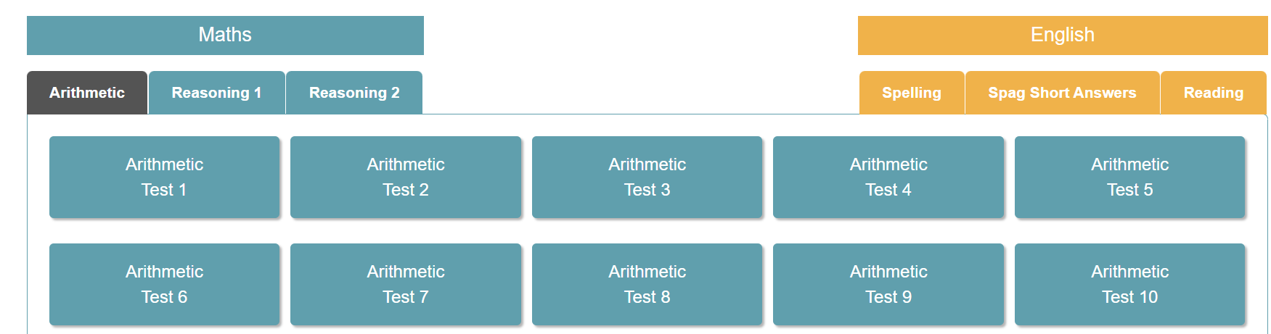
How you can help
All children will soon have their own login for Bootcamp.
If your child is finding a particular question or subject area tricky they must speak to their class teacher. Often we have multiple ways of explaining the same concept.
Encourage children to use SATs Bootcamp for revision.

Slide 18
Breakfast Club
During SATs week, we offer the option for children to come into school from 8:15 am and have breakfast. This has been hugely popular when we have done this in the past: it helps ensure that children are in school on time, have the chance to ask any last minute revision questions and most importantly gives them time to have something to eat and relax with their friends in a calm environment before sitting their tests.
Further information about this will be sent home nearer the time.

Slide 19

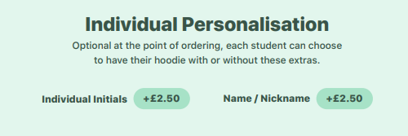
Leavers hoodies
Our online shop is open so that you can order.
Children will be able to wear them in school
during the LAST week of term only.

